Slide 1
iTPU
Error, Loss and MSE
How a model knows it is wrong - and how it gets better
Error | Loss | MSE | RMSE | MAE | R² | Log-loss | Accuracy
Notes:
Today's question: how does a model know that it is wrong, and how does that number help it improve?

Slide 2
The big question
Why do we need a loss?
The problem
The idea
The use
A model makes thousands of predictions. Some are good, some are bad. It cannot 'see' how well it is doing.
We turn all its mistakes into ONE number. That number is the LOSS.
The model changes its weights to make this number smaller. That is learning.
Analogy: a teacher checks 30 exams. The director asks "How is the class?" The teacher answers with ONE number: "the average is 72". A loss does the same for a model.
iTPU
Error, loss and MSE | how a model knows it is wrong
Notes:
Start with the need: many predictions, one number to judge them all.

Slide 3
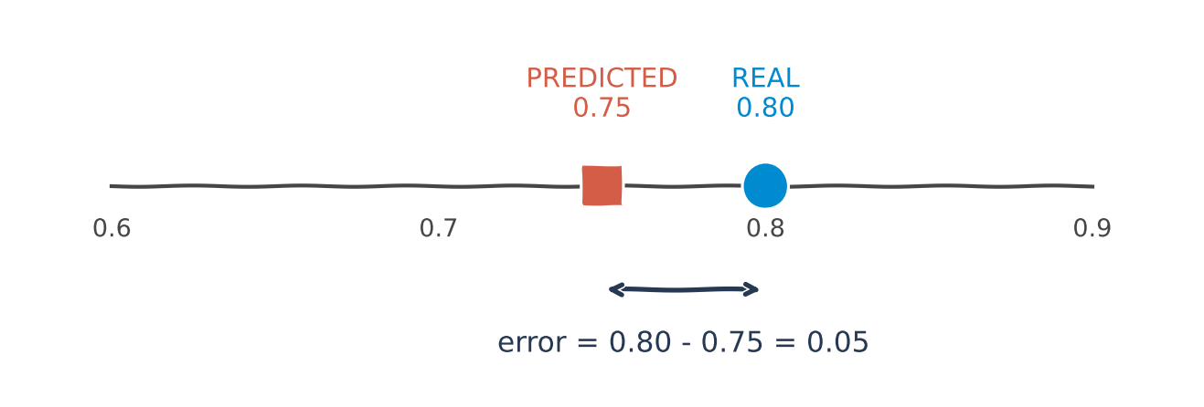
Step 1: error
Error = how wrong ONE prediction is
error = real value - predicted value | Real productivity 0.80, model says 0.75 | The model missed by 0.05 | Positive error: predicted too low. Negative: too high.
Remember: an error belongs to ONE example.
iTPU
Error, loss and MSE | how a model knows it is wrong
Notes:
One team, one prediction, one error.

Slide 4
Step 2: loss
Loss = all the errors turned into ONE number
Team
Real
Predicted
Error
Error²
MSE
0.0042
1
0.80
0.75
0.05
0.0025
2
0.70
0.70
0.00
0.0000
3
0.60
0.70
-0.10
0.0100
MSE = (0.0025 + 0.0000 + 0.0100) / 3 = 0.0042
Three teams, three errors -> one number that describes the whole model.
iTPU
Error, loss and MSE | how a model knows it is wrong
Notes:
Walk through the table row by row. The last column feeds the MSE.

Slide 5
MSE
MSE: Mean Squared Error in 3 steps
1
ERROR
2
SQUARE
3
MEAN
for each example: real - predicted
multiply each error by itself
take the average of all the squares
MSE = (1/n) × Σ (real - predicted)²
The name tells you the recipe: Mean of the Squared Errors.
iTPU
Error, loss and MSE | how a model knows it is wrong
Notes:
Read the name backwards: errors, squared, mean.

Slide 6
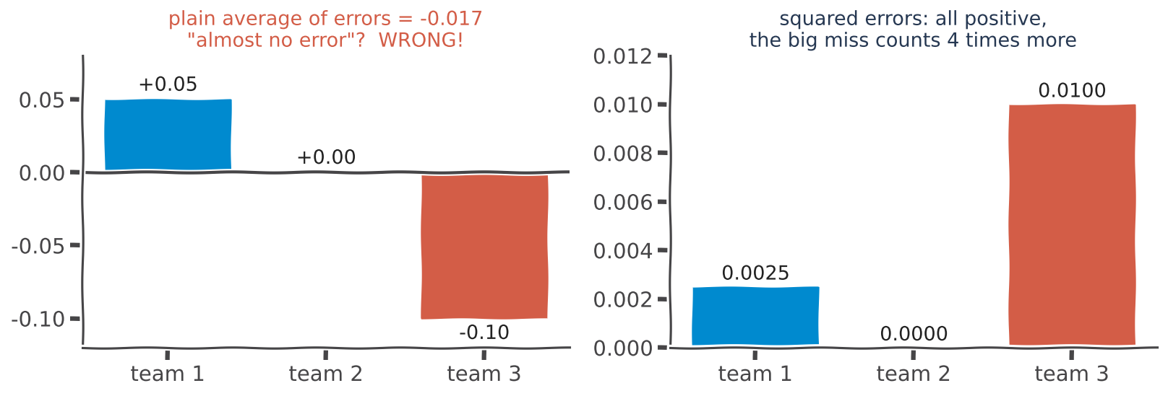
Why square?
Why do we square the errors?
Reason 1: without squares, +0.05 and -0.10 cancel out and the average looks tiny | Reason 2: squares punish big mistakes more: 0.10 is 2x bigger than 0.05, but its square is 4x bigger
Remember: squaring makes every error positive and makes big mistakes expensive.
iTPU
Error, loss and MSE | how a model knows it is wrong
Notes:
Left: the plain average lies. Right: squares tell the truth and punish the big miss.

Slide 7
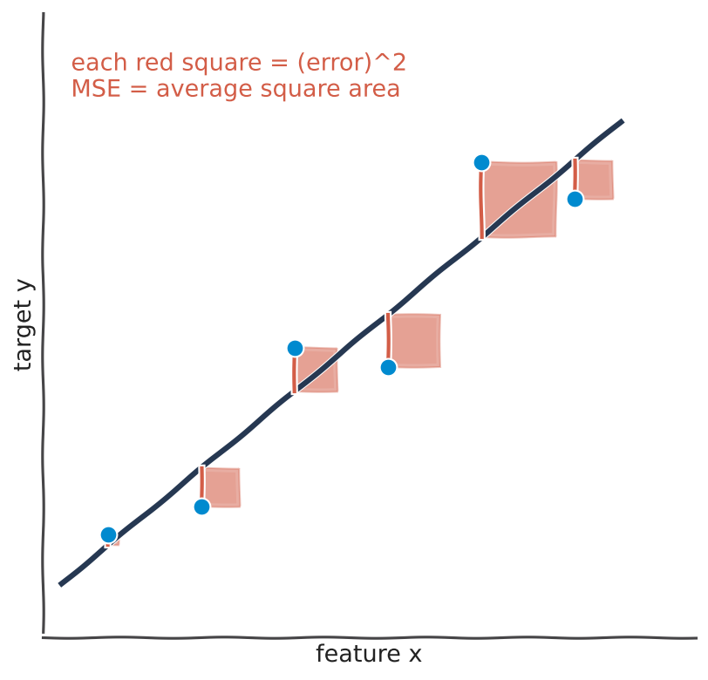
See it
MSE as a picture: the area of the red squares
KEY IDEA
Blue dots = real values; the line = predictions
Each red square = one error, squared
MSE = the average area of the squares
A better line = smaller squares
Remember: the best line is the one with the smallest squares.
iTPU
Error, loss and MSE | how a model knows it is wrong
Notes:
Draw attention to the biggest square: that is the point the line misses most.

Slide 8
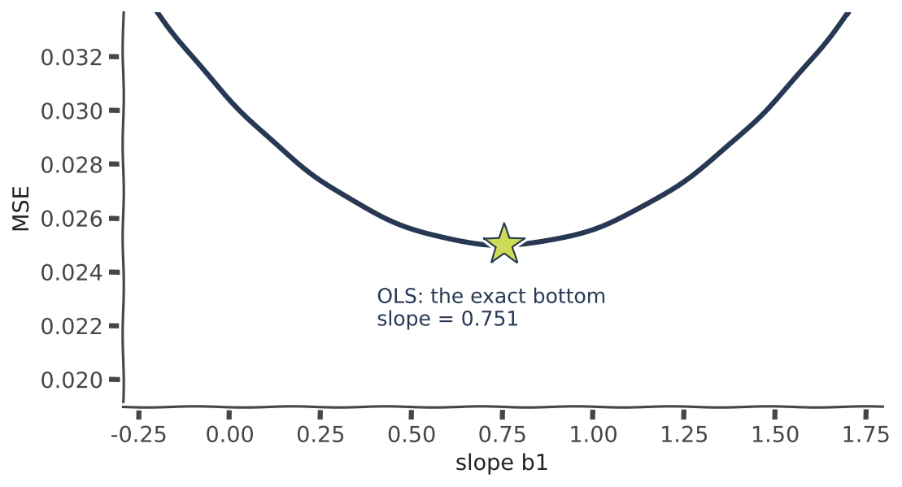
Why ML needs it
The loss is the model's compass
KEY IDEA
1. The model predicts
2. We compute the loss
3. Gradient descent changes the weights to make the loss smaller
4. Repeat thousands of times
The bottom of the bowl = the best weights
Remember: without a loss, the model does not know which way to move.
iTPU
Error, loss and MSE | how a model knows it is wrong
Notes:
Link to Topic 7: the loss is the mountain; training walks down to the valley.

Slide 9
Good or bad?
Is 0 good, or is 100 good?
Errors and losses
Quality scores
MSE, RMSE, MAE, log-loss
SMALLER is better
Best possible = 0
0 means the model never makes a mistake
Accuracy, R²
BIGGER is better
Best possible = 100% (accuracy) or 1 (R²)
There is no universal 'good' MSE: it depends on the UNITS.
Productivity (0 to 1): our MSE is 0.0217. House prices in dollars: a good model can have an MSE in the millions.
So never judge an MSE alone - compare it with a baseline.
iTPU
Error, loss and MSE | how a model knows it is wrong
Notes:
The key rule: errors want to be small, scores want to be big. And MSE needs a comparison.

Slide 10
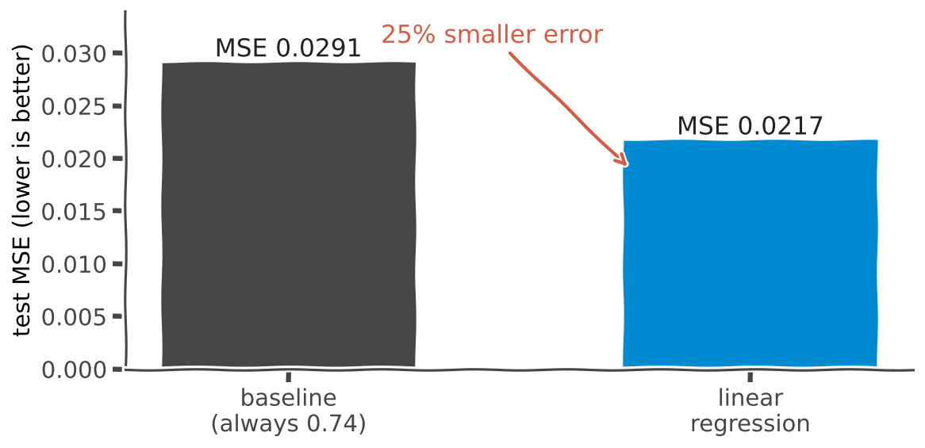
Baseline
Compare with the baseline
KEY IDEA
Baseline = the simplest model: always guess the average (0.74)
Baseline MSE = 0.0291
Our model MSE = 0.0217
Our model makes a 25% smaller error
Remember: a model is only useful if it beats the baseline. One AutoCode test checks exactly this.
iTPU
Error, loss and MSE | how a model knows it is wrong
Notes:
This comparison gives the MSE its meaning.

Slide 11
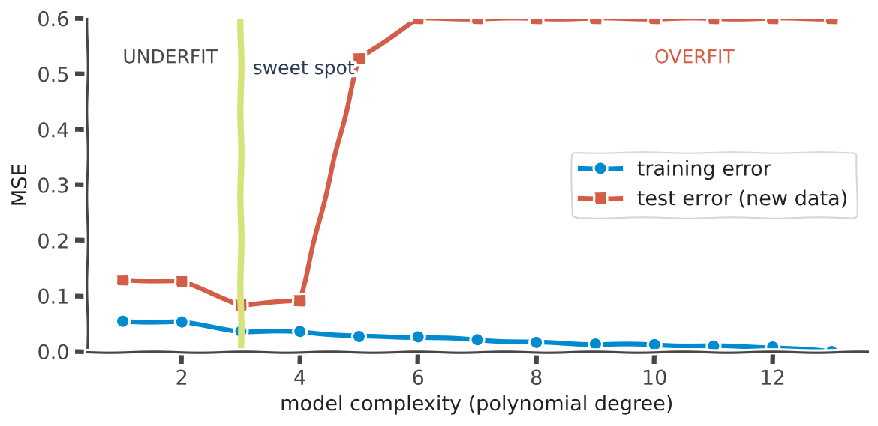
Careful
Warning: training error = 0 is NOT a win
KEY IDEA
Training error keeps going down as the model gets more complex
Test error goes down, then shoots up
Training MSE of 0 usually means the model memorised the data
Always judge the TEST error
Remember: the error that matters is the error on NEW data.
iTPU
Error, loss and MSE | how a model knows it is wrong
Notes:
Example: a student who memorised last year's answers gets 100% at home and fails the real exam.

Slide 12
The family
Error and quality measures you will meet
Measure
How it is calculated
What it tells you
Best value
MSE
average of squared errors
overall error; big mistakes count a lot
0
RMSE
√MSE
typical error, in the ORIGINAL units
0
MAE
average of |errors|
average size of a mistake; less sensitive to outliers
0
R²
1 - model MSE / baseline MSE
how much better than always guessing the average
1
Log-loss
classification loss (Topic 9, Part 3)
punishes confident wrong answers
0
Accuracy
correct predictions / all predictions
share of correct answers
100%
Our garment model: MSE 0.0217 RMSE 0.147 R² 0.25
iTPU
Error, loss and MSE | how a model knows it is wrong
Notes:
RMSE 0.147 means the model is typically off by about 0.15 productivity. R² 0.25 means 25% better than the baseline.

Slide 13
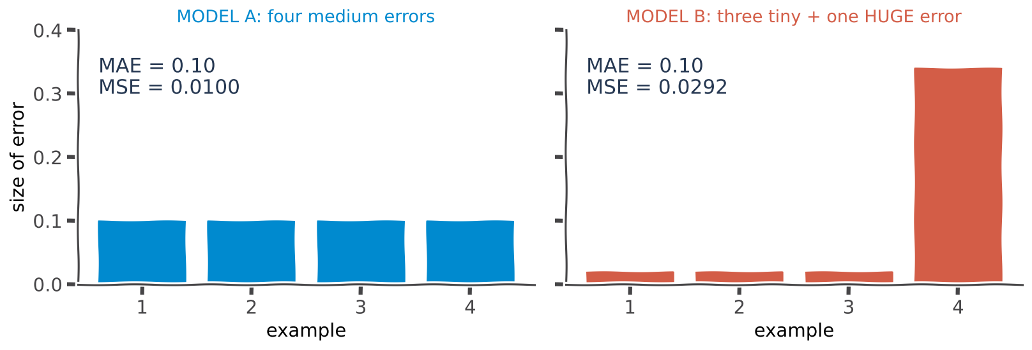
MAE vs MSE
MAE or MSE? The outlier test
Both models have the same MAE: 0.10 | But model B has one huge error | MSE notices it: 0.0292 vs 0.0100 | MAE treats all errors equally; MSE punishes big ones
Remember: use MSE when big mistakes are dangerous; use MAE when your data has many outliers.
iTPU
Error, loss and MSE | how a model knows it is wrong
Notes:
Same average mistake, very different risk.

Slide 14
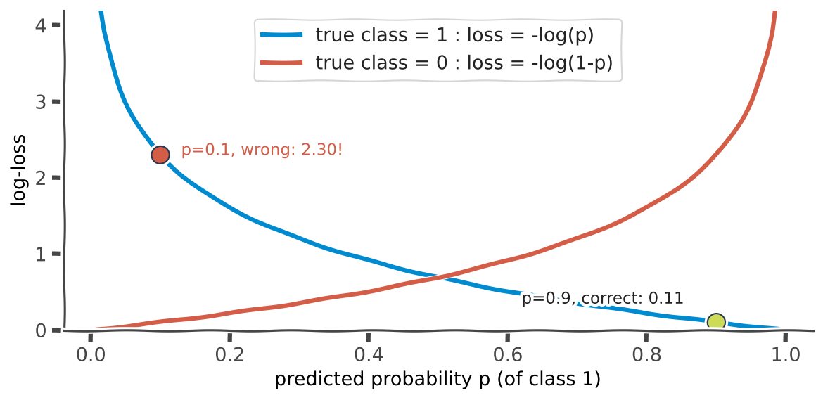
Loss vs metric
Loss is for the model, metric is for people
KEY IDEA
LOSS: the model minimises it during training; it must be smooth
METRIC: we report it to people
Regression: MSE (loss), RMSE or R² (metric)
Classification: log-loss (loss), accuracy (metric)
Remember: confident and wrong costs the most: p = 0.1 for a true 1 gives a log-loss of 2.30.
iTPU
Error, loss and MSE | how a model knows it is wrong
Notes:
Accuracy jumps in steps, so we cannot compute a gradient from it. That is why training uses log-loss.

Slide 15
Which one when?
Which measure should I use?
Training a regression
Explaining to people
Many outliers
Classification
MSE
smooth, easy gradient, punishes big mistakes
RMSE or MAE
in the original units: 'we are off by about 0.15'
MAE
one crazy value does not dominate
train with log-loss,
report accuracy
And always: compare with the baseline, and judge the TEST data.
iTPU
Error, loss and MSE | how a model knows it is wrong
Notes:
Four situations, four choices.

Slide 16
ACTIVITY | 2 minutes
Your turn: calculate the errors
Example
Error
|Error|
Error²
1. MAE = average of |errors| = ?
1
0.1
?
?
2
-0.2
?
?
2. MSE = average of errors² = ?
3
0.3
?
?
3. RMSE = √MSE = ?
4
0.0
?
?
4. The baseline MSE is 0.05. Is this model better?
iTPU
Error, loss and MSE | how a model knows it is wrong
Notes:
Two minutes. Answers on the next slide.

Slide 17
Answers
Answers
Example
Error
|Error|
Error²
MAE: (0.1 + 0.2 + 0.3 + 0) / 4 = 0.15
1
0.1
0.1
0.01
MSE: (0.01 + 0.04 + 0.09 + 0) / 4 = 0.035
2
-0.2
0.2
0.04
3
0.3
0.3
0.09
RMSE: √0.035 ≈ 0.187
4
0.0
0.0
0.00
Better?: Yes: 0.035 < 0.05 (30% smaller error)
iTPU
Error, loss and MSE | how a model knows it is wrong
Notes:
R² here would be 1 - 0.035/0.05 = 0.30.

Slide 18
Summary
Five things to remember
Error
how wrong ONE prediction is: real - predicted
Loss
all errors turned into ONE number; the model makes it smaller while it learns
MSE
mean of squared errors: no cancelling, big mistakes cost more
0 or 100?
errors and losses: 0 is best. Accuracy and R²: bigger is best
Judge fairly
compare with the baseline, and always look at the TEST error
iTPU
Error, loss and MSE | how a model knows it is wrong
Notes:
Close with these five lines.

